Slide 1
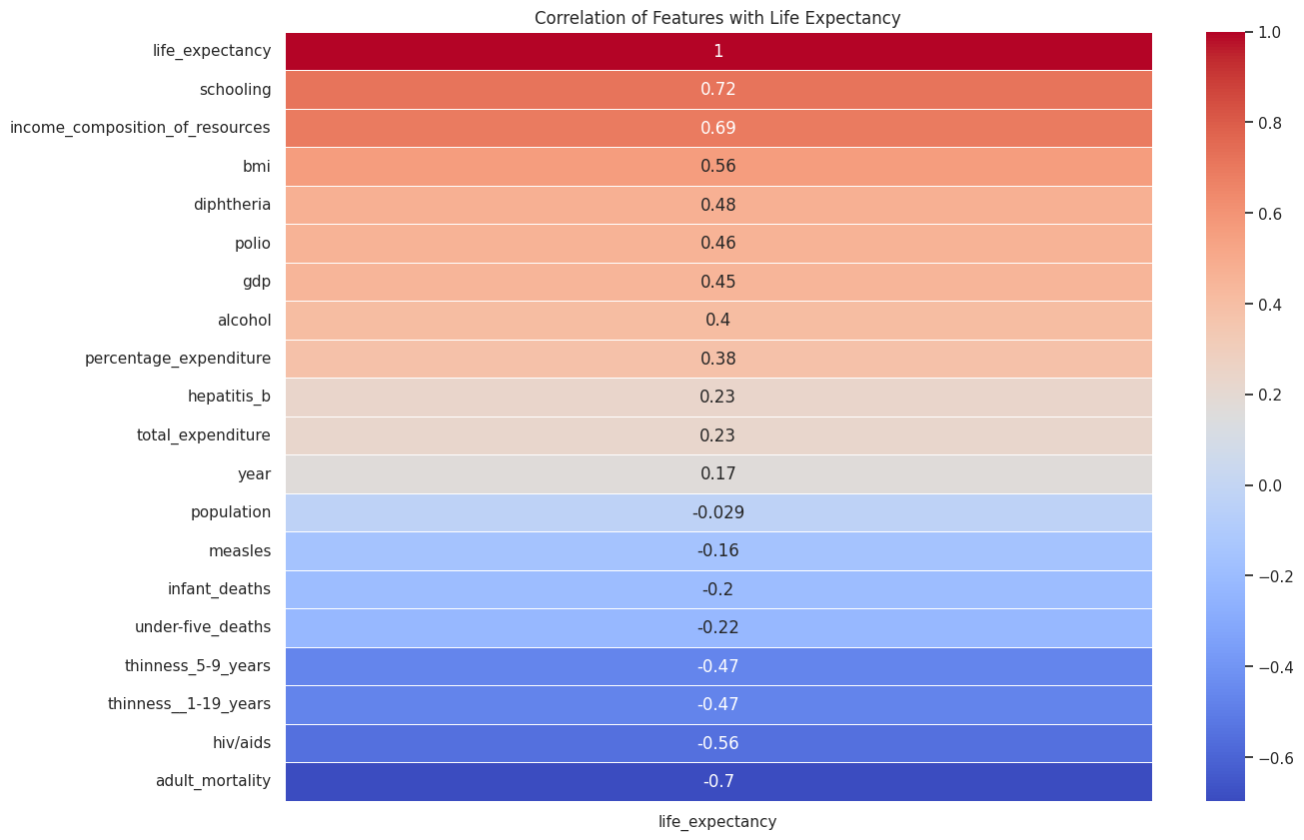



Methods:
Statistics +
Machine Learning
+ SHAP
Life Expectancy Analysis
Insights, Predictions & Explainability
Presented by
Ritika Roy

Slide 2
Project Objectives
Analyzing global life expectancy variations
Identifying health, economic & lifestyle factors influencing lifespan
Comparing prediction with dataset median & mode
Predicting life expectancy using machine learning
Making the model explainable with SHAP

Slide 3
Dataset Overview
Source: WHO (2000–2015)
Samples: ~2,900 records from 193 countries
Target Variable: life_expectancy
Key Features:
Health: adult_mortality, immunization, HIV
Economy: GDP, income composition
Lifestyle: alcohol, BMI, schooling
Country status (developed/developing)

Slide 4
Data Cleaning & Preprocessing
Handling Missing Values
Dropping rows where Life expectancy is missing (target variable)
Filling numeric columns with an appropriate strategy
Total expenditure: first by country mean, then fallback to global mean
Schooling: first by country mean, then fallback to global mean
Using global mean for remaining features
Cleaned column names
Imputed missing values using:
Group-wise mean/median
Global median for fallback
Encoded categorical values (country, status)
Scaled features using StandardScaler
Final dataset: Clean, balanced, ready

Slide 5
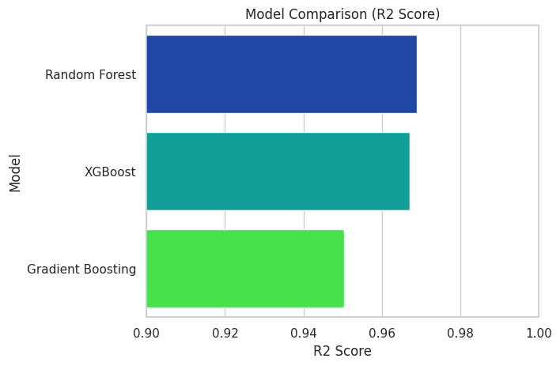
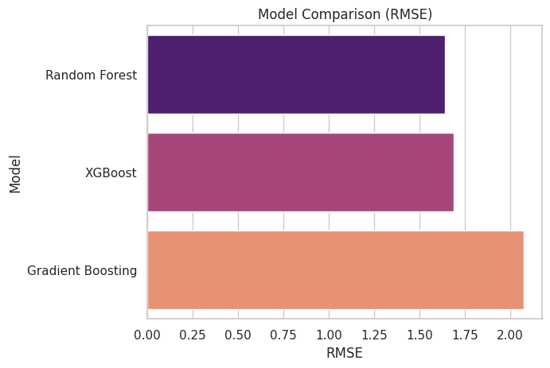
Machine Learning Models Used
Split: 80% Train / 20% Test
Evaluated using:
R² Score
RMSE
Cross-Validation (K-Fold, 10 splits)
Model Results Comparison
Model | R² Score | RMSE
Random Forest | 0.9688 | 1.64
XGBoost | 0.9671 | 1.68
Gradient Boosting | 0.9502 | 2.07
Best Model: Random Forest

Slide 6
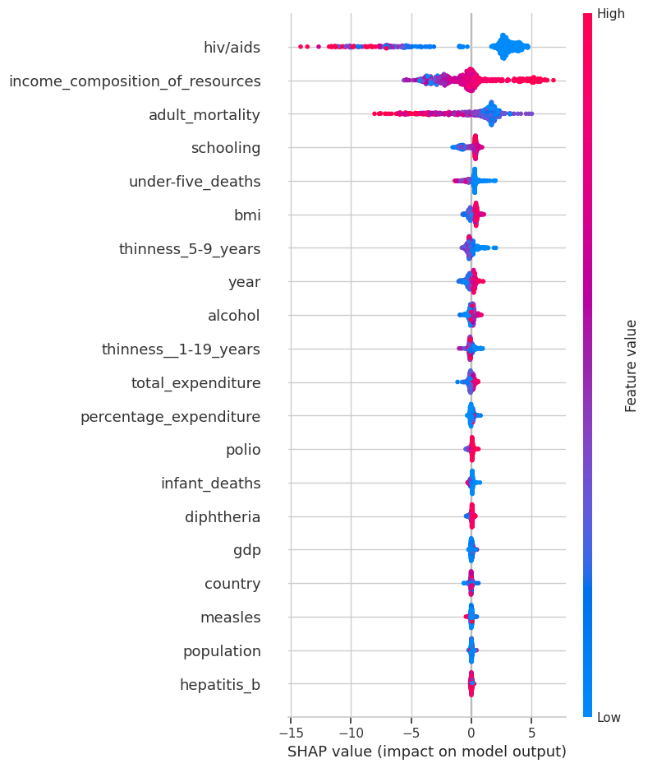
SHAP Value Summary
SHAP helps explain the "why" behind model decisions
Top contributors to life expectancy: schooling, income_composition_of_resources, adult_mortality, bmi
SHAP shows both magnitude & direction of influence
Each point is a country’s prediction
Helps visualize how features push predictions up or down
Supports fairer, more interpretable decision-making

Slide 7
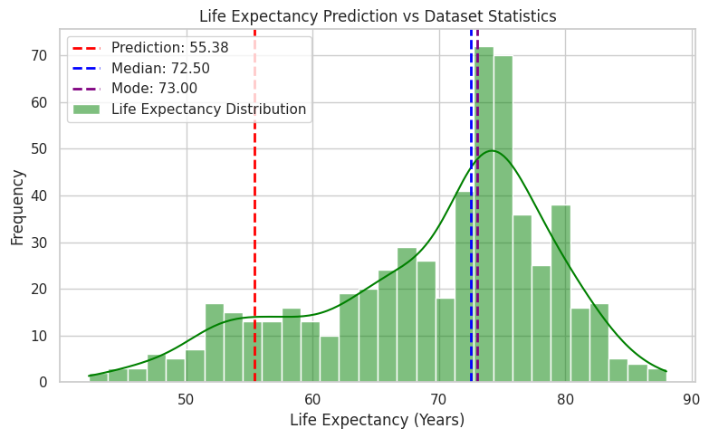
Model Prediction vs Median/Mode
00
Highlights the model’s ability to personalize based on feature context
Majority of test data lies in 65–75 years range
A few developing countries are below 60
Mode value aligns well with actual spread

Slide 8
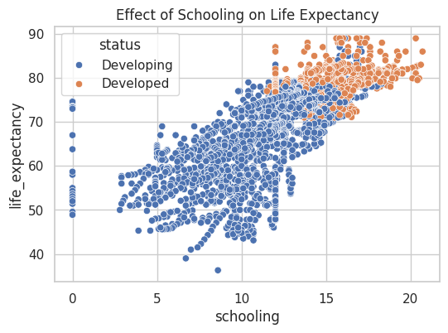
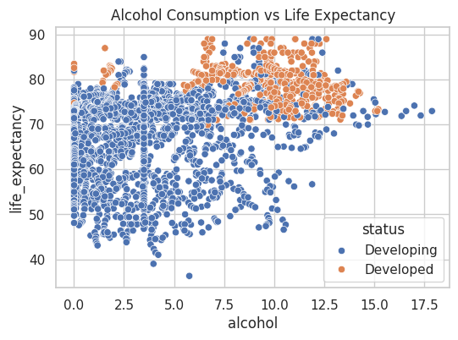
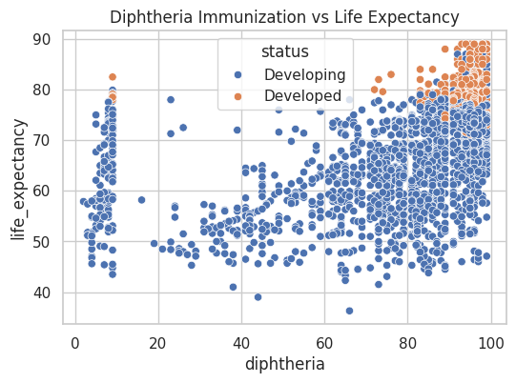
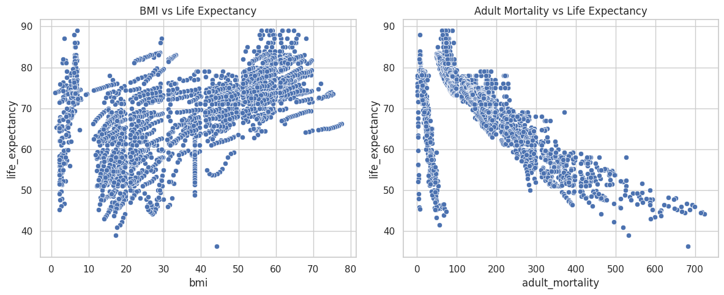
Conclusion
Schooling has a strong positive correlation with longer life.
Adult mortality and infant deaths reduce life expectancy significantly.
Healthcare spending, immunization rates, and nutrition (BMI) are major contributors.
Developing countries showed significantly lower life expectancy than developed ones.
ML models predict life expectancy with ~97% accuracy
SHAP reveals key interpretable patterns
Policy Advice:
Invest in education and preventive health
Tackle mortality via immunization
Consider schooling as strong lever for improving lifespan

Slide 9
Thank You!

